Slide 1
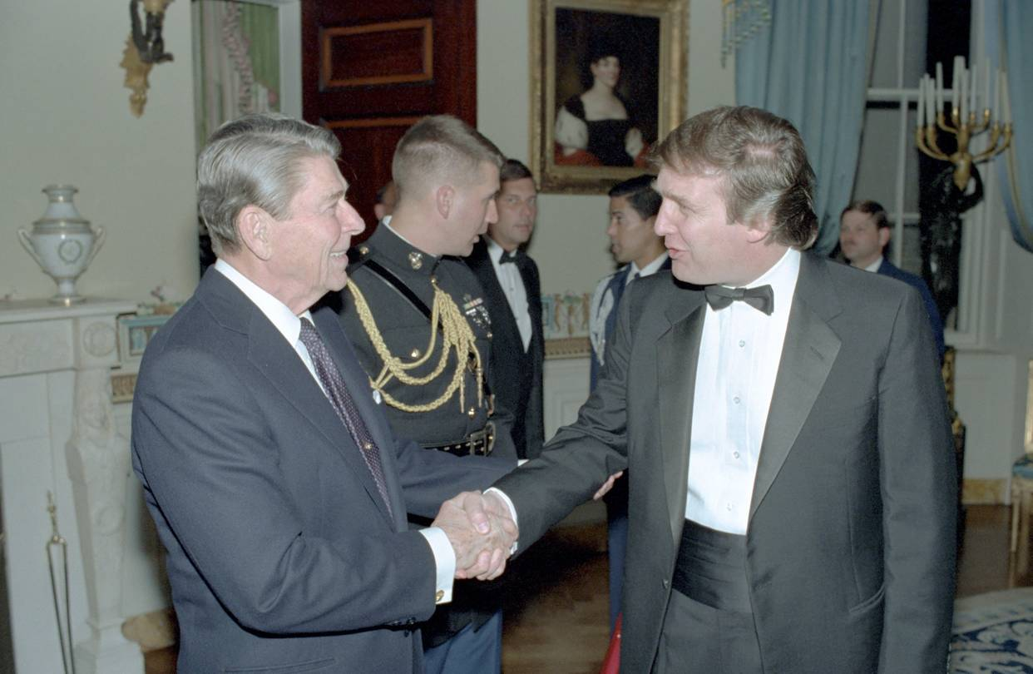
The Trump Presidency in Historical Context
Artemus Ward
Dept. of Political Science
Northern Illinois University
aeward@niu.edu
http://www.niu.edu/polisci/about/faculty-staff/full-time-faculty/ward-site/
Greenfields
Geneva, IL
April 26, 2017

Slide 2
American Political Time
There is a recurring pattern in presidential history, which starts when a transformative presidency creates a new political order out of the ashes of an older one (think the transition from Hoover to FDR).
This transformative president is typically followed by a loyal disciple (Harry Truman, for example), and then by a president of the opposite party who has little choice but to operate within the existing political order (Dwight Eisenhower).
As long as a given political order persists, power rotates between presidents who are devoted to the reigning political orthodoxy (John F. Kennedy and Lyndon Johnson) and those who resist that orthodoxy but can’t quite dislodge it (Richard Nixon).
The cycle ends with a president who seeks to uphold a political order that is on the verge of collapse due to internal conflicts and contradictions that grow ever more difficult to reconcile.

Slide 3
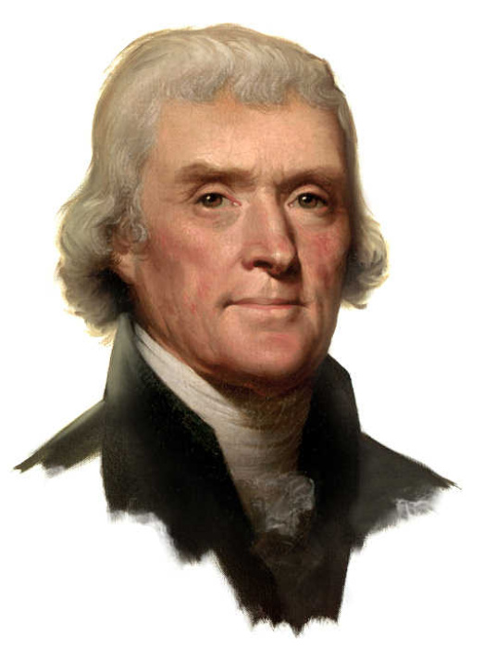
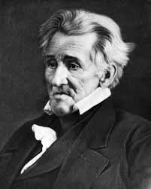
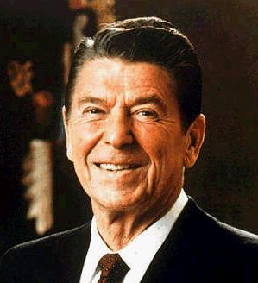
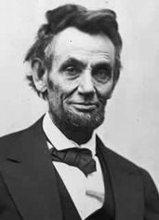
American Political Regimes: Reconstruction
A regime begins with a reconstruction. A president, and other office holders, are elected with expansive warrants to repudiate the politics of those who came before.
These presidents transform the ideological commitments of the nation and fashion a coalition of various interests in order to gain and wield power.
These presidents are generally thought of as the most successful presidents in American history: Jefferson, Jackson, Lincoln, FDR, and Reagan.

Slide 4
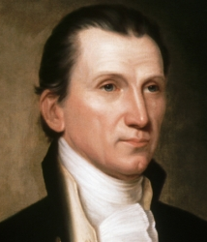
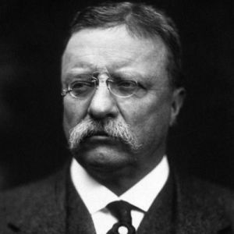
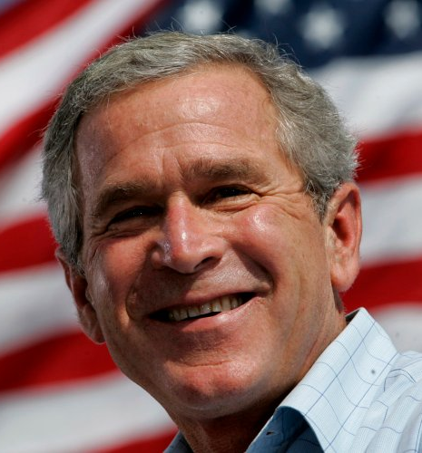
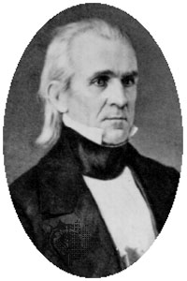
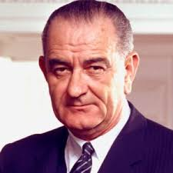
American Political Regimes: Articulation
Reconstructive presidents are followed by presidents from the same party who articulate the regime’s commitments.
These are the “heir apparents” and “faithful sons” who apply the orthodoxy of the regime to new issues that arise.
But in doing so, the coalition of interests that held together during the reconstruction begins to fray and these presidents often abdicate or otherwise depart the office under heavy criticism: Monroe, Polk, Theodore Roosevelt, LBJ, and Bush II.

Slide 5
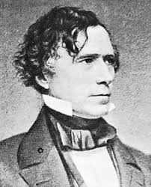
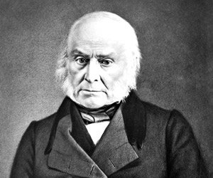
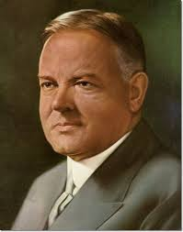
American Political Regimes: Disjunction
Elected toward the end of a political regime, disjunctive presidents are nominally affiliated with the regime (and the reconstructive and articulative presidents who came before them) and preside over the regime’s downfall as the ideological commitments of the regime are called into question and the coalition of interests that held the regime together becomes untenable.
Disjunctive presidents are generally considered among the worst in American history: John Quincy Adams, Pierce, Hoover, and Carter.

Slide 6
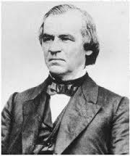
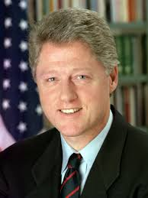
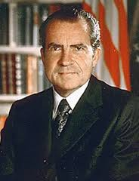
American Political Regimes: Preemption
In between the presidencies held by those affiliated with the political regime are presidents from the opposition party who temporarily preempt the regime.
These are the wild cards of American politics with some preemptive presidents able to achieve success (e.g. Cleveland, Eisenhower) by moderating their party’s positions on issues and working with the party that transformed the regime.
However, because they are opposition presidents, they have critics on all sides who attempt to delegitimize them and destroy their presidencies.
Thus, preemptive presidents are often delegitimized and/or impeached: Andrew Johnson, Nixon, Clinton.

Slide 7
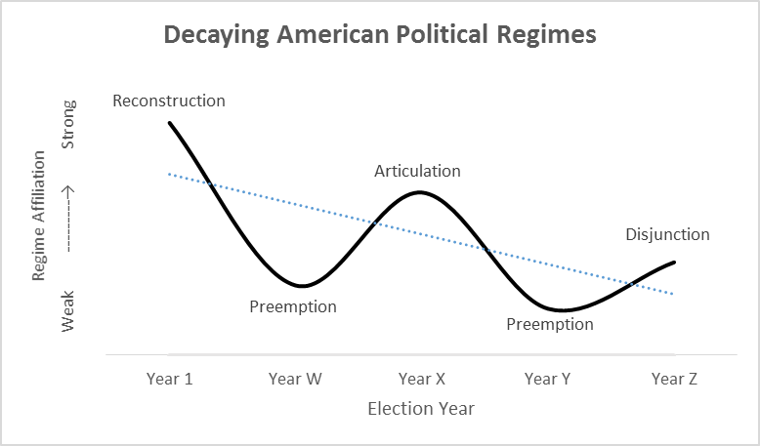

Slide 8
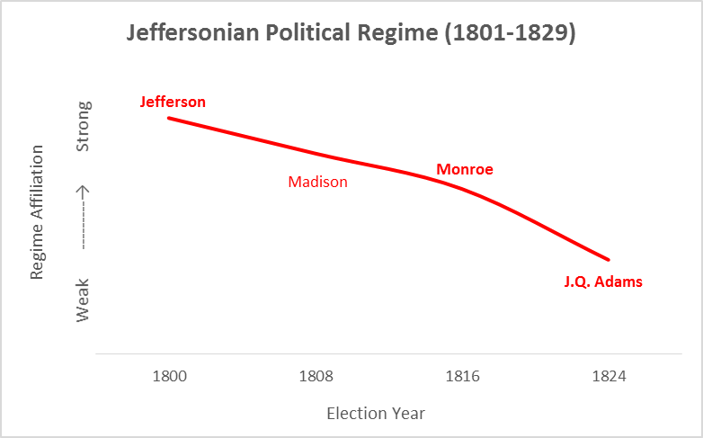

Slide 9
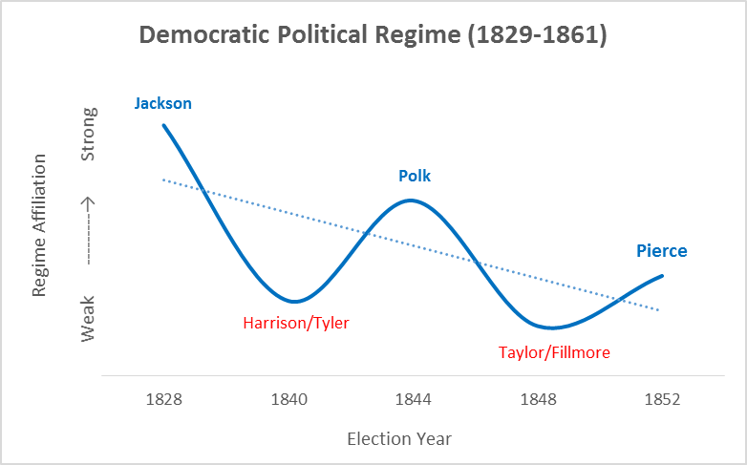

Slide 10
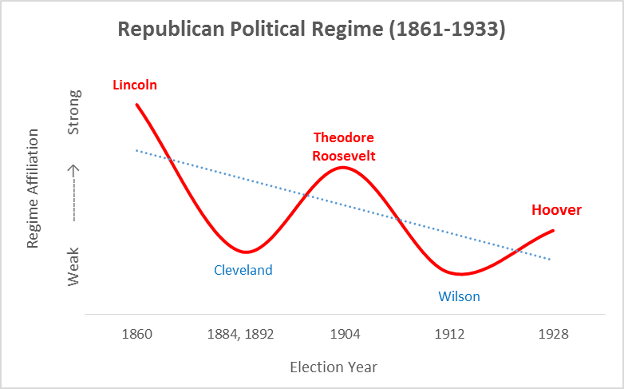

Slide 11
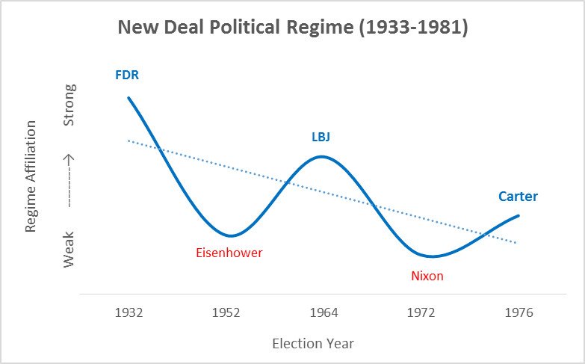

Slide 12
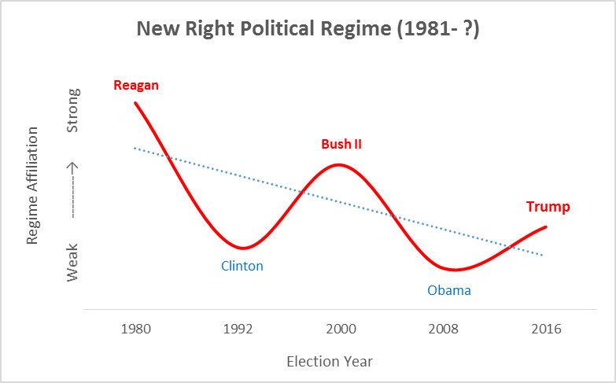

Slide 13
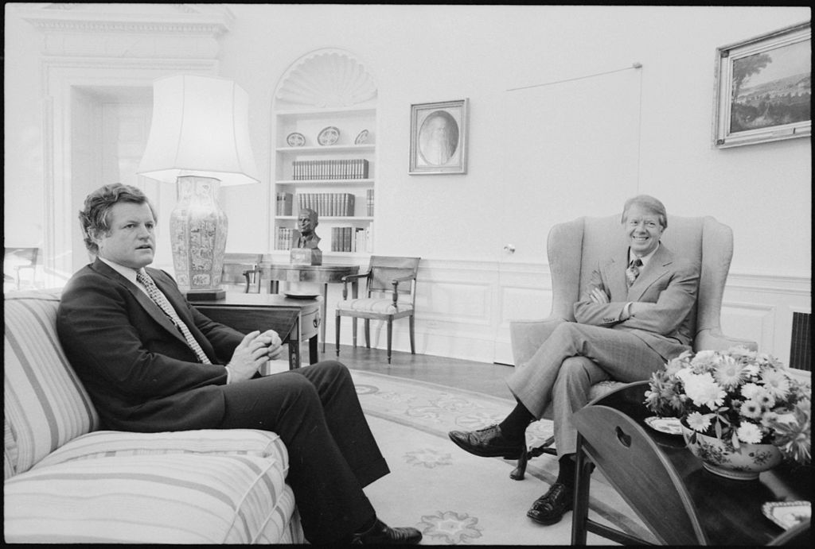
Carter’s Disjunction
Carter’s presidency fits the classic politics of disjunction: a president who seeks to uphold a political order that is on the verge of collapse due to internal conflicts and contradictions that grow ever more difficult to reconcile.
The Georgia governor tried to keep together a New Deal coalition that united Northern liberals and Southern conservatives via his idiosyncratic mishmash of Christian moralism, technocratic wonkery, and willingness to reform New Deal policy in a more conservative direction.
He instead triggered intense intra-party opposition, up to and including a formidable primary challenge from Ted Kennedy.
Carter’s “disjunctive” presidency inevitably failed and paved the way for the next transformative presidency: Ronald Reagan’s.

Slide 14
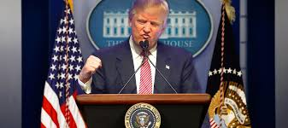
Predictions for the Trump Presidency
Should the patterns of presidential leadership in political time hold true, Trump is the disjunctive president in the decaying New Right political regime that began with Reagan.
Like similarly situated presidents in political time, there were serious questions over whether he was truly a Republican as he campaigned and adopted policy positions that were formerly associated with liberal Democrats (e.g. infrastructure spending, protectionism on trade, health care for all, support for social security and medicare, acceptance of gay rights).
The divisions in the GOP between the moderate (socially liberal, economically conservative) and conservative (socially conservative, economically populist) wings were highlighted during the GOP nomination phase of the 2016 election and continued during Trump’s presidency with Republicans taking sides either for or against Trump on various nominations and policy proposals.
The Democrats will exploit these divisions and ultimately unite behind a new presidential candidate who will repudiate Trump (who will be widely seen as a failed president like the similarly situated presidents before him: Carter, Hoover, Pierce, J.Q. Adams) and most likely reconstruct American politics in a “New Left” political regime.

Slide 15
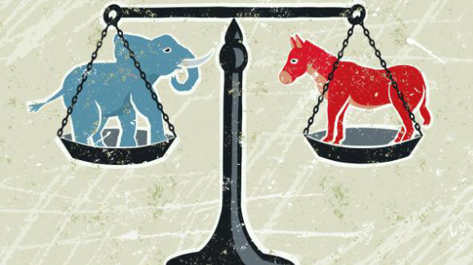
Predictions for the Trump Presidency
According to literature on American political regimes, the 2016 election of Donald Trump reflects the decaying of the New Right coalition ushered in by Reagan.
The disenchantment that voters feel about the country will continue until a new regime reconstructs the nation’s politics.
What that new regime will look like depends on what the American people broadly want. And there may be a party realignment taking place even now.
If the GOP becomes the party of Trump, moderate Republicans may switch party affiliations and become Democrats. If the Democrats become the party of Sanders/Warren, moderate Democrats may switch their party affiliations and become Republicans.

Slide 16
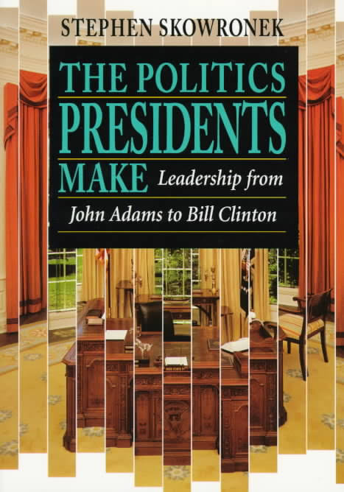
Further Reading
To learn more about the rise and fall of American political regimes and presidential leadership in political time, see:
Skowronek, Stephen, The Politics Presidents Make: Leadership from John Adams to Bill Clinton, revised ed. (New York: Belknap Press, 1997).
Skowronek, Stephen, Presidential Leadership in Political Time: Reprise and Reappraisal, 2nd ed. (Lawrence: University Press of Kansas, 2011).
For a brief history of each American presidential election, see:
Boller, Paul F. Jr., Presidential Campaigns: From George Washington to George W. Bush (New York: Oxford University Press, 2004).

Slide 17
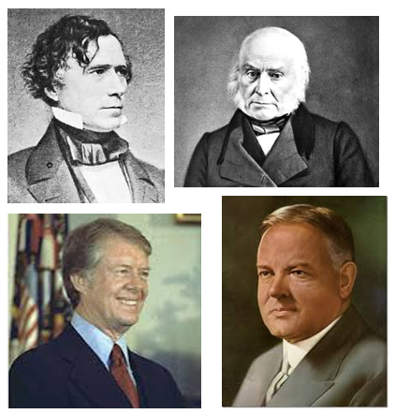
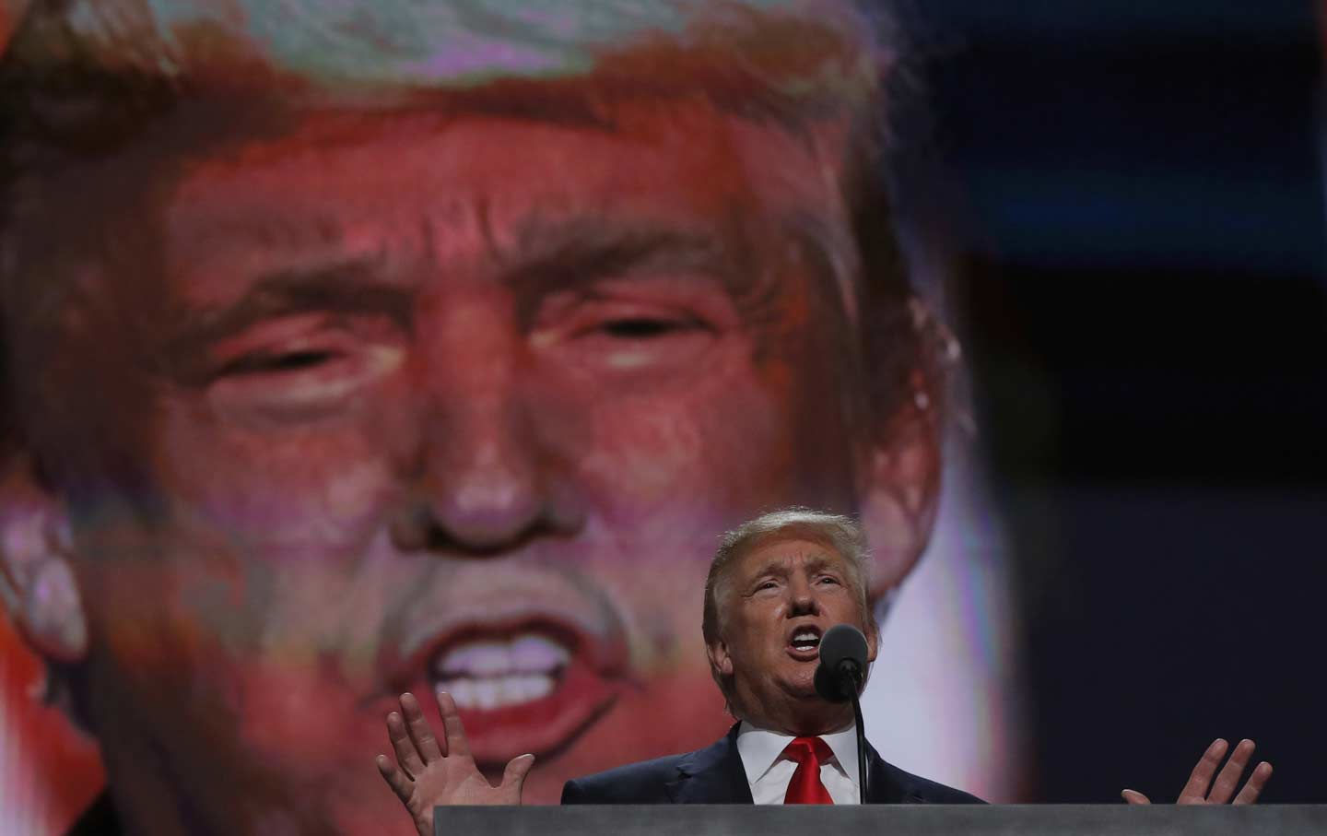
Donald Trump and the Common Characteristics of Disjunctive Presidents

Slide 18
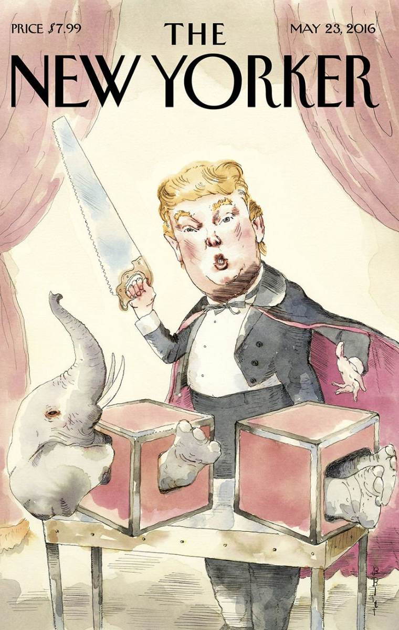
Dark Horse Candidate
Disjunctive presidents gain office as “dark horse” obscure candidates removed from party strength and interest who hail from regions with the greatest erosion of majority party support.
Trump was the ultimate dark horse candidate.
Unlike every president who came before him, he had no military or government experience.
Few expected Trump would run for president. Few expected he would win the GOP nomination. Few expected he would defeat Democrat Hillary Clinton.
Trump hailed from New York City—a place no one would have expected to find a Republican presidential candidate due to the decades-long erosion of GOP support not only there but in the northeast and urban areas generally.

Slide 19
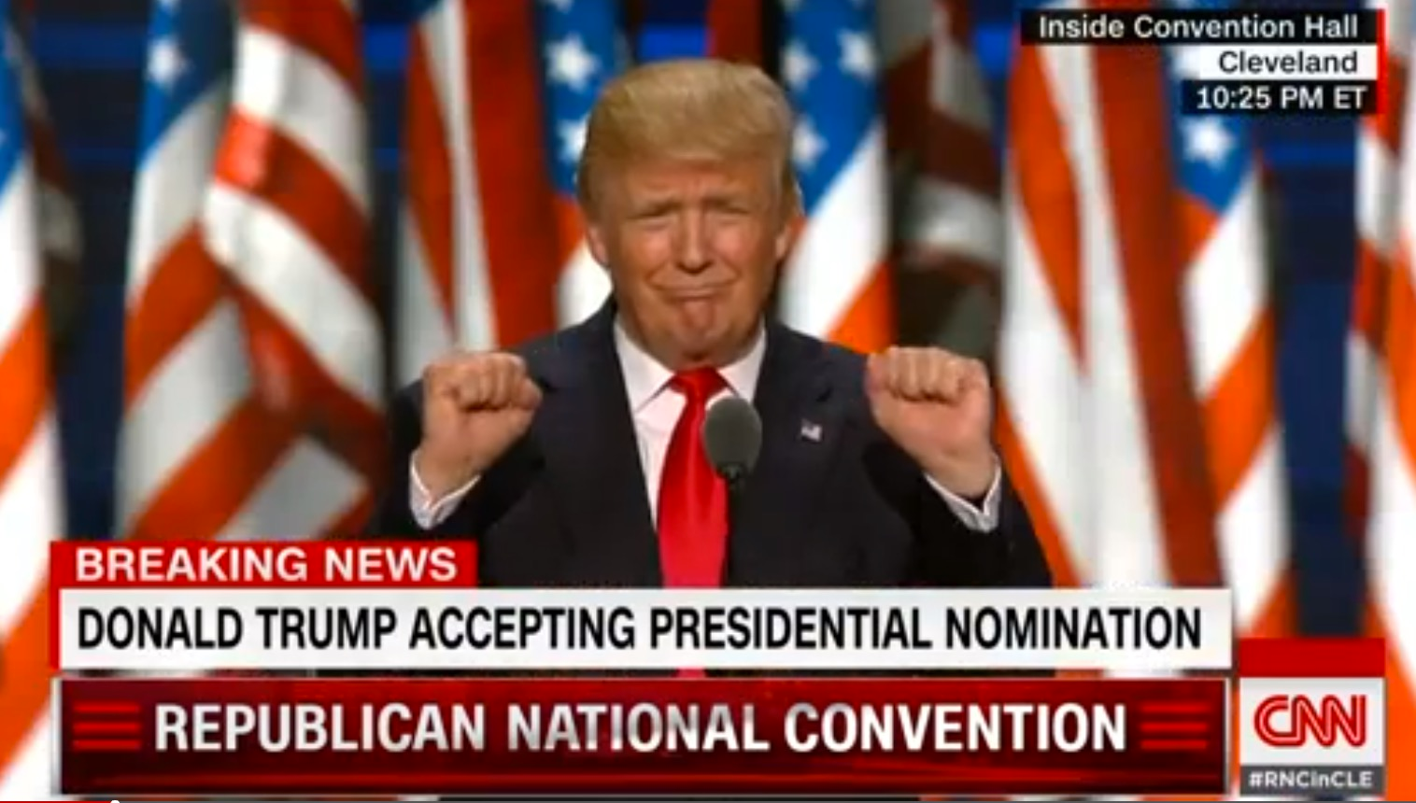
Political Loner with Special Expertise
The most profound thing said by Donald Trump was at the Republican National Convention in July 2016: “I alone can fix it.” That was a tell-tale sign of what kind of president he was going to be.
He was saying, “I’m not going to rely on my own party to do this.” That smacks of Jimmy Carter, who distanced himself from his fellow Democrats by asking, “Why not the best?”
The kind of president who reigns over the end of his party’s own orthodoxy is always someone with no relationship to his party establishment, someone who catches the popular mood and says he is going to do it all by himself.
Someone like Herbert Hoover, who carefully cultivated his own political brand and image as a “wonder boy”—the guy who can fix anything.
Disjunctive presidents are always loners. If Trump is not Andrew Jackson, and if he is Jimmy Carter—as the theory suggests—then Paul Ryan is Ted Kennedy circa 1978.

Slide 20
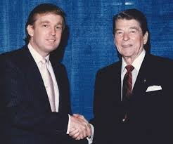
Insider Critic as Savior of Old Order
Disjunctive presidents are insider critics, alert to the crisis
of legitimacy of the existing order, and intent on saving it.
Trump was always a Reagan-era insider. As a wealthy businessman, Trump was necessarily involved in supporting political campaigns and lobbying government officials. Trump and his corporations benefited from the relatively low-tax, business friendly policies of the New Right political regime.
Yet he was always a critic of what he saw as the shortcomings of the policy commitments of the regime involving trade, immigration, foreign aid, and foreign wars. He even, at times, directly criticized Reagan and his GOP successors.
While Trump’s rhetoric was often anti-establishment and critical of the regime, he generally paid tribute to Ronald Reagan and explained how his “Make America Great Again” slogan was meant to return the nation to Reagan’s America.

Slide 21
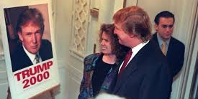
Outsider Untainted by Divisive Politics of Past
At the same time, disjunctive candidates are seen as outsiders,
untainted by the divisive politics of previous decades.
Disjunctive candidates identify themselves with popular disillusionment with political insiders and entrenched special interests.
Campaigning as an outsider from within the regime is awkward because the candidate lacks the kind of freedom that opposition presidents have to oppose established interests. Nor does the candidate have the regime insider’s freedom to promote established interests. The result is difficulty establishing credibility.
The reality is that Trump had always been an insider, in the sense that he was a major campaign donor, befriended politicians, was a high-profile public figure, and had plainly benefited from the low-tax, business-friendly, media-driven environment of the prior decades.
But he could easily claim outsider status having no formal Washington or governmental experience.
He flirted with a presidential run in 1988. He failed to gain support and lost to conservative pundit Pat Buchanan when he flirted with the Reform Party’s presidential nomination in 2000.
And while his prior statements, relationships, and donations were scrutinized during the 2016 campaign, he was not seen as someone tied to the divisive politics of the past.
He pledged to “drain the swamp” of established interests, yet in his cabinet picks he largely chose people from the military and business establishment.

Slide 22
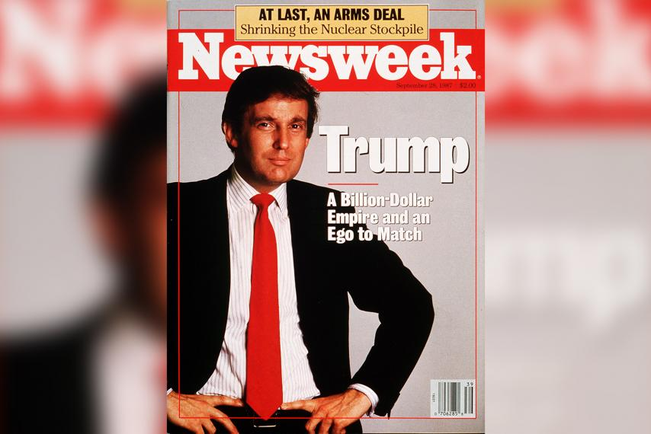
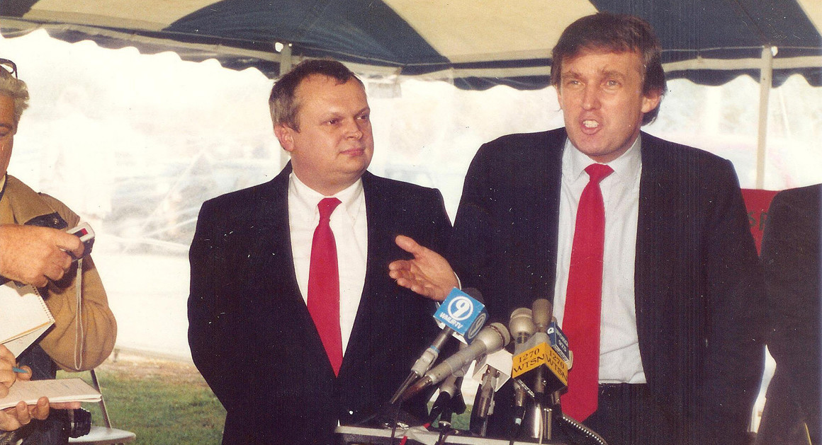
In Oct. 1987, Trump spoke in New Hampshire. He railed, with no notes, and for roughly the next half hour, about Japan, Iran, Saudi Arabia, Kuwait, Washington, Wall Street, politicians, economists and “nice people” of whom he had “had enough,” he said.
This country was facing “disaster” and was “being kicked around.” Other countries were “laughing at us.” “It makes me sick,” Trump said. “If the right man doesn’t get into office,” he warned, “you’re going to see a catastrophe in this country in the next four years like you’re never going to believe. And then you’ll be begging for the right man.”

Slide 23
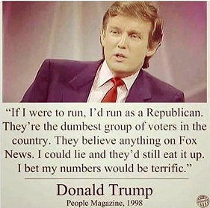
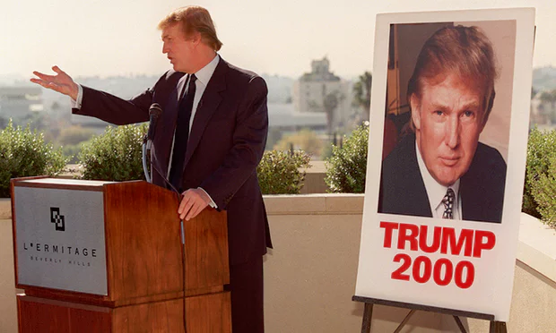
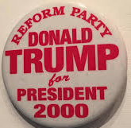
In 2000 Trump’s exploratory campaign consisted only of media appearances and meet-and-greets with Reform party members in Florida, Connecticut and California. Trump’s ideas included a one-time tax on the rich to eliminate the national debt. He declared North Korea the greatest threat to the US. He described himself a “big fan” of the economic embargo against Cuba and accused Japan (not China) of “ripping us off.”
He disparaged the field of Republican contenders as “a bunch of stiffs.” He criticized politicians who make too much of their humble origins as “just losers,” while wealthy establishment candidates were dismissed as members of a “lucky sperm club.” Asked about his image as a womanizer, he offered that if that was an impediment to his candidacy, “I’m not going to bother.”
Trump, who had resigned his membership of the Republican party, told reporters he believed the GOP has become “just too crazy right.” Trump said he believed “non-politicians represent the wave of the future.” “I’m not prepackaged. I’m not plastic. I’m not scripted. And I’m not ‘handled’. I’ll tell you what I think. It’s quite a departure from the usual office-seeking pols,” Trump wrote in The America We Deserve, a book published to coincide with his Reform party bid.
He recognized TV was the key to political success. “So much depends on if you happen to be talented in that medium, if you can get your point across,” he told CBS’s Dan Rather. “Being good on television doesn’t necessarily make you a good president, but if you’re not good on TV, you’re not going to be president.”

Slide 24
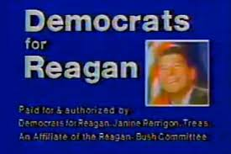
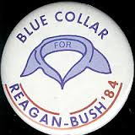
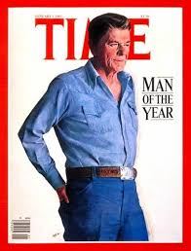
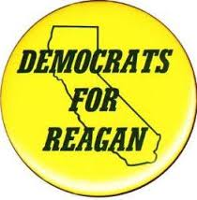
Key Coalition Member Returns
Disjunctive candidates bring back a key coalition member who had grown skeptical of the regime and either not voted or voted for the opposition recently.
Disjunctive candidates successfully reassemble the previously broken coalition in order to win election.
Trump was elected by working-class whites—so-called “Reagan Democrats”—who had voted Democrat during the New Deal regime, voted for Reagan at the start of the New Right regime, but defected to Obama or did not vote at all in prior elections out of protest that the regime had not delivered on its promises.

Slide 25
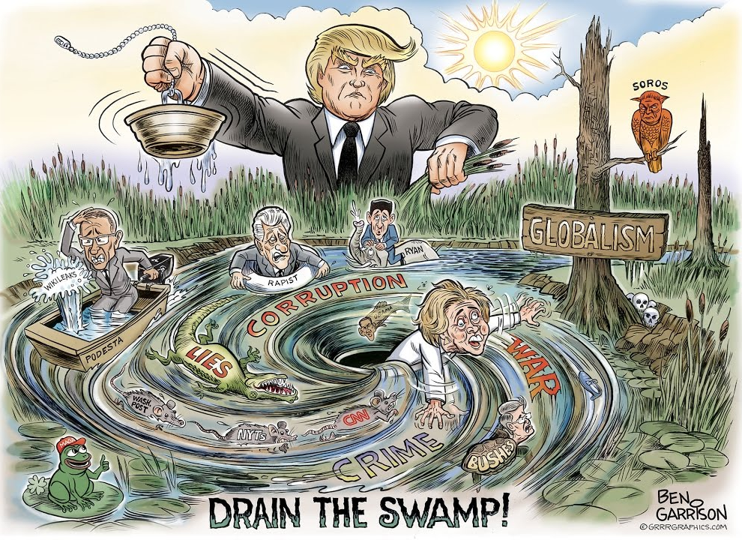
New Right Orthodoxy on the Defensive
Supporters of the New Right orthodoxy are on the defensive.
During the 2016 campaign, Trump immediately dispatched of GOP challengers who were seen as part of the establishment and therefore part of the problem: Jeb Bush, Chris Christie, Marco Rubio.
During his transition he talked about “draining the swamp” of the special interests, lobbyists, and DC insiders (even though his cabinet selections were dominated by military and business elites).
During his inauguration speech he castigated the politics of the past all while the people responsible for those politics were seated around him, including Republicans: former President George W. Bush, former Speaker John Boehner, and current Speaker Paul Ryan and Senate Majority Leader Mitch McConnell.

Slide 26
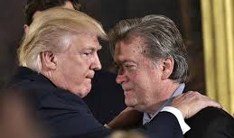
Technocratic Appeals
Caught between outsider and insider, disjunctive presidents become preoccupied with problems of administrative form, procedure, and discipline (bureaucratic inefficiencies, technocratic appeals) rather than the substantive content of the regime. The problem lies in technique and personnel—not substance. The reason this is attractive to disjunctive presidents is that they would rather not make choices among the regime’s substantive interests. Because no interest of political significance depends on the president’s success at reorganization, plenty of party interests will oppose it and it will dissolve into institutional confrontation.
During the transition, the incoming administration considered reforming the intelligence community including abolishing the Director of National Intelligence.
One month into the new administration, Trump chief strategist Steve Bannon said that a key administration goal was the “deconstruction of the administrative state” through deregulation of business.
Trump’s Supreme Court appointment, Neil Gorsuch, was a proponent of ditching the “Chevron” deference rule where federal judges are supposed to defer to federal agency interpretations of statutes as opposed to congressional interpretation.

Slide 27
Expedience Eclipses Enthusiasm
Expedience eclipses enthusiasm in the bond between the regime and the nation and between the majority party and the president. Eventually, what begins as expedience simply dissolves into irrelevance.
Trump’s voters were not all of one mind. While perhaps half of his supporters were enthusiastic about him, the others only voted for him because he was the GOP nominee, not the Democratic nominee, or because they were casting a protest vote against the establishment. Many were single-issue voters, caring only about the vacancy on the Supreme Court remaining in GOP hands.
Trump was never embraced by some GOP members in government and only tepidly supported by others. During the campaign, GOP officials said they would vote for him but would not endorse him. During the transition, GOP leaders said they would work with him where they could but opposed him on many of his policy positions.
Some of his cabinet nominees, even if ultimately approved, were harshly questioned by GOP Senators (e.g. Sec. of State Rex Tillerson was vociferously attacked by Marco Rubio; Betsy DeVos for Education opposed by GOP Senators Susan Collins and Lisa Murkowski and confirmed 51-50) or some failed because they withdrew over concerns from numerous GOP Senators (Vincent Viola for Army Secretary, Andrew Puzder for Labor Secretary, Philip Bilden for Navy Secretary, Todd Ricketts for Deputy Commerce Secretary).

Slide 28
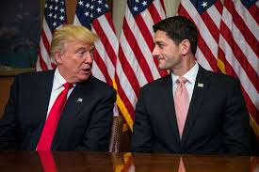
Catch-22
The instinctive political stance of the establishment affiliate—to affirm and continue the work of the past—becomes at these moments a threat to the vitality, if not survival, of the nation, and leadership collapses upon a dismal choice: To affirm established commitments is to stigmatize oneself as a symptom of the nation’s problems and the premier symbol of systematic political failure; to repudiate them is to become isolated from one’s most natural political allies and to be rendered impotent.
Consider the issues of tax policy, deficit spending, and wealth inequality. Should Trump continue the Reagan-era low-tax, high-spend policies that have produced massive budget deficits and the greatest wealth inequality in a century, he will be easily labeled by Democrats as the incarnation of everything that is wrong with the current regime and vulnerable to electoral defeat. Should he instead chart a new course, he will alienate Republicans who will not cooperate and seek to defeat him themselves.
In short, no matter what a disjunctive president does, he will be attacked and destroyed one way or the other.

Slide 29
Struggle for Credibility
Because disjunctive presidents are only tenuously attached to a governmental establishment that itself appears barren of any interest in addressing the most pressing problems of the day, the disjunctive president’s leadership turns on the basic question of credibility.
Despite concerted efforts to establish credibility, disjunctive presidents cannot reconcile their own awkward position in the old order with the awkward position of the old order in the nation at large.
Trump’s credibility was regularly questioned during the campaign with as many as 80% of his statements judged false or misleading—far higher than any other candidate in modern history (generally candidates are around 30% at most). Once in office, Trump and his surrogates continued to regularly propagate falsehoods over both seemingly unimportant issues such as the size of his inauguration crowd to major ones including allegations of millions of fraudulent votes in the election and President Obama wiretapping Trump Tower. Only 50 days into his presidency, Trump made at least 194 false or misleading claims — an average of about four daily.
Trump regularly changed his positions on issues throughout the campaign, during the transition, and in office. During the campaign, he said that women should be punished for abortions before quickly changing his stance. During the transition he said that press briefings might be removed from the West Wing press room to the Old Executive Office Building across the street, but quickly dropped the idea. After saying he would appeal and fight unfavorable judicial rulings on his Muslim ban, he shifted gears and said he would instead simply issue a new one. After issuing the new ban, he said that his aides made him do it and that he would have rather appealed the initial ban to the Supreme Court.
Rep. Devin Nunes (R-Calif.) went so far as to chide reporters for asking questions about the wiretap claim, saying, “I think a lot of the things he says, I think you guys sometimes take literally.” How can democracy function when people cannot take the president literally?
Trump’s flexibility (or inconsistency) is a microcosm of the old order’s struggle to remain consistent with first principles.

Slide 30
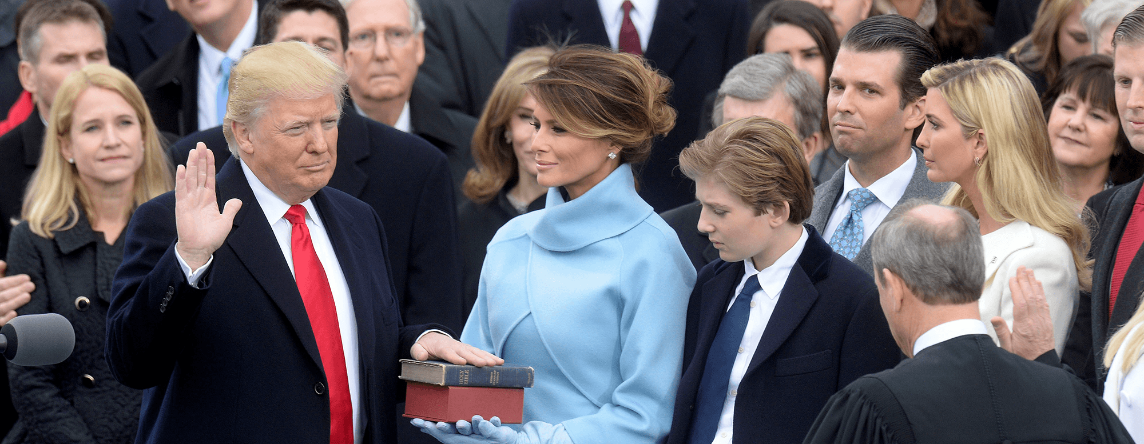
Struggle for Credibility
If a disjunctive president attempts to be bold, exercise leadership, and establish credibility (rather than defer to congress) the president will quickly find that he has no political foundation for such a stance. Why? Because no interest of any significance depends on the president’s success.
Narrow election victories are indicative of the fragility of the regime.
Trump lost the popular vote by 3 million including some GOP voters who were “Never Trump” voters.
Trump only won the electoral college vote thanks to 80,000 voters in Wisconsin, Michigan, and Ohio who gave him narrow victories in those states and therefore the presidency.
Disjunctive presidents exhaust their party’s national strength and legitimacy simply by letting them elect him (or at least not oppose him). These leaders have no stake in following the president and no intention of suspending their normal suspicions in order to enhance the president’s position.
Regime stalwarts in congress are secure at the same time their president is not.
GOP Senate stalwarts John McCain and Lindsey Graham regularly spoke out against the president’s statements and policy positions. Speaker Paul Ryan and other GOP congressional leaders were only somewhat supportive of Trump, depending on the statements and positions he espoused.

Slide 31
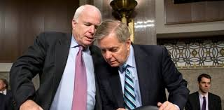
Difficulty in Mobilizing Political Support
A disjunctive president’s stance is as vulnerable to opponents as being more of the same as it is vulnerable to affiliates for being different.
Disaffection within the coalition makes the mobilization of political support more difficult for disjunctive presidents.
He entered office with a 40% approval rating—lowest of any president in modern history, and a 55% disapproval rating—highest of any incoming president in history.
GOP elites criticized his policies. Sen. Lindsey Graham (R-SC) said of the immigration ban: “If politics is music, the president was off-key.” Sen. John McCain (R-AZ) said: “In my view, it was an unnecessary and frankly harmful open dispute.” More than half of Americans opposed the ban.
Trump’s support for a plan to repeal and replace Obamacare was opposed by a majority of Americans and scuttled by GOP House members of the Freedom Caucus.

Slide 32
Sectarian Interests Drive Politics
Party operators don’t realize that they are toying with moral issues of explosive significance for the nation as a whole.
The regime becomes increasingly dependent on sectarian interests with myopic demands and momentary loyalty.
A rule of myopic sects defies the very notion of governmental authority. Gripped by myopic sects, the party is bankrupt as a governing instrument.
Sectarian interests such as working-class whites, Christian Evangelicals, and gun-rights advocates each pressed Trump to meet their demands. Instead of governing from the center, Trump catered to their concerns, making it virtually impossible to expand his base and improve on his roughly 40% approval numbers.
Myopic demands – Many of Trump’s actions were opposed by the majority of Americans and strong arguments were made that they were shortsighted, imprudent, even intolerant:
a proposed return to torture and re-opening CIA “black sites” was scuttled due to opposition from senior lawmakers, including Sen. John McCain (R-AZ) and officials in the administration including CIA Director Mike Pompeo and Secretary of Defense Jim Mattis.
the immigration ban from 7 majority-Muslim countries was opposed in its breadth by a number of Trump cabinet officials who were not consulted and Homeland Security Secretary John Kelley who sought to issue waivers for green-card holders while Trump’s key strategist Steve Bannon wanted a total ban.
Momentary loyalty – Many Trump voters had voted previously for Obama, disliked Trump personally, and had been Democrats previously.

Slide 33
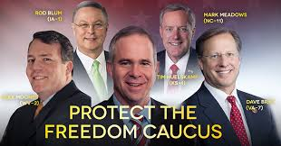
Legislative Opposition
Factions who feel mistreated in patronage or policy will exact revenge by withholding support for the president and instead support opposition candidates and legislation.
Remarkably “insignificant” legislative disagreements and “scandal” can quickly derail a disjunctive president and highlight his inability as an outsider to make the government work and address the nation’s manifest problems.
The immediate scandal of the Trump presidency was Russian government intervention in the 2016 presidential election to harm Democrat Hillary Clinton’s candidacy. Tump’s posture during the campaign of embracing policies that were in Russia’s interests and his positive comments about Russian President Vladimir Putin put him at odds with Republican orthodoxy and raised questions about his motivations and possible business links with Russia. He denied having any.
Questions over whether Trump or his campaign officials had acted in concert with Russian officials grew louder as National Security Advisor Michael Flynn resigned amid revelations that he spoke to Russian officials during the transition about potentially lifting sanctions the Obama administration had just put in place to punish Russia for its interference. Members of both parties in congress promised bipartisan investigations into the affair. Two months into the Trump presidency, the House Intelligence Committee questioned FBI Director James Comey about the matter. Comey took the unusual step of commenting on it, explaining that there was an ongoing investigation that began in July 2016.
When party leaders pass a bill that goes against a promise made by the disjunctive president, he has to choose—party or nation—either choice results in a loss of credibility with the other.
Trump supported the GOP House-initiated bill to repeal and replace Obamacare even though many of its provisions went against promises made by Trump—namely that every American would be covered and that their health care would be cheaper and better than it was under Obamacare. The House bill never made it to a vote as both GOP House moderates and conservative Freedom Caucus members opposed it—despite last-minute negotiations including threats by Trump.
Trump’s first budget set spending priorities immediately opposed by GOP lawmakers—namely huge cuts to all federal agencies and programs except for Defense, Homeland Security, and Veteran’s Affairs. Trump’s budget was declared “dead on arrival” in congress.
Administration victories offer precious little upon which to vindicate the promise of rehabilitation of the old order.
After 100 days all Trump could point to was a Supreme Court appointment (which was largely due to conservative legal groups and Mitch McConnell) and a series of executive orders attempting to undo what he could from the Obama presidency. No major legislation was enacted even though Trump promised major changes either on “day one” or in the first hundred days.

Slide 34
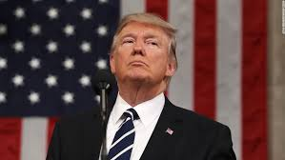
Deepening Crises
A disjunctive president’s resolve to find his own way through deepening crises increasingly comes to be seen as rootless floundering.
Every new revelation surrounding the Trump campaign’s ties to Russian meddling in the election was followed by Trump’s attempts to deflect and distract. He accused President Obama of wiretapping Trump Tower, he criticized government leakers who provided information to the press, and otherwise strenuously denied every allegation.
The roll-out of the immigration ban received as much coverage for Trump’s failure to properly vet, clarify, and communicate the policy within the administration and with GOP congressional leaders (how it was drafted and to be implemented) as it did for its substance (what it actually said and did).
As the government neared a shutdown in his first 100 days, Trump first said that any plan to keep the government open must include funding for his border wall. He then changed course and said it was not necessary and that the wall would be built later.

Slide 35
Cabinet Shake-Ups
Cabinet shake-ups only lend credence to the image of an administration out of control. In the first 100 days:
Internal struggles among the White House staff dominated the early weeks of the Trump presidency. Three weeks into his job, National Security Advisor Michael Flynn was forced to resign over revelations about his potentially illegal contacts during the campaign and transition with the Russian ambassador to the United States and other Russian intelligence operatives, and his misleading statements about the matter to senior Trump administration officials including Vice President Mike Pence. This scandal fueled the already brewing controversy surrounding Trump’s ties to Russia.
Deputy national security adviser K.T. McFarland, who had been brought on by Flynn, is expected to leave her post soon to become U.S. ambassador to Singapore.
Deputy White House Chief of Staff Katie Walsh left after the first two months.
Boris Epshteyn, special assistant to the president, was in charge of managing all TV appearances by White House officials but departed before the end of the first quarter.
Gerrit Lansing resigned as White House chief digital adviser after a month because he was unwilling to cut financial ties to a company in which he held an ownership stake.
Anthony Scaramucci was named as the head of the Office of Public Liaison and Intergovernmental Affairs, but three weeks later it was taken away from him.
Trump’s own pick to be the NSC’s senior director for Western Hemisphere Affairs, Craig Deare, was dismissed in mid-February after word got back to the White House that he’d trashed the president and chief strategist Steve Bannon during an off-the-record event hosted by the Woodrow Wilson Center.
Shermichael Singleton, a senior adviser to HUD Secretary Ben Carson and one of Trump’s relatively few African American political appointees, had been planning a cross-country tour for Carson but was escorted out of HUD headquarters by security after someone completing his background check found a critical op-ed he wrote about Trump last fall for The Hill.
Jason Miller was supposed to be White House communications director until he suddenly announced on Christmas Eve that he wanted to focus on his family instead.
Monica Crowley was to oversee communications in a senior job on Trump’s National Security Council, but she was felled by a plagiarism scandal the week before Trump took office. In March, she registered with the Justice Department as a foreign agent for Ukrainian oligarch Victor Pinchuk.

Slide 36
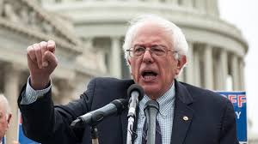
Radical Insurgencies
The disjunctive president’s hapless struggle for credibility fuels radical insurgencies which will soon reconstruct American politics.
To be sure, as with Trump’s rise, the rise of the Bernie Sanders and the growth of his following during the 2016 campaign was a reaction to the discontent with status-quo politics. These insurgent forces were only bolstered after Trump’s victory on election night and formed the foundation for the numerous mass protests (e.g. women’s march, airport protests around travel ban, etc.) and hostile town-hall meetings with members of congress that followed during Trump’s transition and presidency.
Opponents eventually adopt the critiques disjunctive presidents had been making and now use them against the president, blurring the lines that the disjunctive president took great pains to initially make.
There will be an insurgent opposition assault on the manifest failings of the regime as a whole which the disjunctive president will be inextricably tied to.

Slide 37
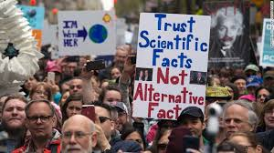
Critical Phase for Social Movements
Disjunction is the critical phase for social movements to gain momentum to lay the foundation for the coming, new regime.
There were immediate protests on election night, the nights after, and during and after the inauguration. In the first 100 days:
Over a million people in cities across the nation marched and rallied over concerns for women’s rights.
Thousands showed up at airports to protest the immigration/travel ban.
Students on college campuses protested speakers who were seen as pro-Trump.
Boycotts of Trump’s businesses were organized.
GOP members of congress saw their town hall meetings overrun by angry constituents.
Tax Day marches saw demonstrators in multiple cities demand that Trump release his tax returns.
The March for Science saw protesters around the country rally to support scientific research.

Slide 38
Is the Politics of Disjunction Necessary?
Although the promise has been made repeatedly and the American electorate has repeatedly responded to it, the task of breathing new life into the old order seems to be beyond the political capacities of the presidential office.
It is probably impossible to skip the disjunction and proceed directly to reconstruction.
The party flounders and fragments in an atmosphere of national crisis.
The energies that once came from advancing great national purposes has dissipated.
It is extremely difficult to see Trump as reconstructive because there are two rules that history suggests must be followed.
The “Obama rule” says that as government becomes more complex, inclusive, and interdependent in its interests (what is known as “political thickening”), the idea that any president can truly reconstruct American politics the way Andrew Jacksonian did, becomes increasingly irrelevant and irrational. Thus, modern presidents would be wise to only promise and strive to deliver incremental, pragmatic government. While Obama certainly overpromised during his 2008 campaign, he governed pragmatically, was re-elected, and left office with a 60% approval rating. Trump has promised transformative change which may very well be institutionally impossible.
﻿The system cannot be transformed without irrefutable evidence that there is no viable alternative. Without a prior disjunction—essentially, a crisis in the reigning orthodoxy of government—demonstrating that the old order is beyond repair, the president won’t be able to seize control of the meaning of his changes. You can’t reconstruct politics if there is not more or less a consensus that what came before was a complete and systemic failure.
Trump won the 2016 election by talking up this fabricated image of the Obama presidency as a failure, but it had very little foundation in reality. To be sure, the Democrats were incompetent in conveying their accomplishments. But Obama left office with a fairly successful economy, a draw-down of unpopular wars, and high favorability ratings for the outgoing president. Trump was able to repudiate Obama rhetorically, but when he attempted to do so in action people started to wonder what was really so bad.
Presidents cannot repudiate a system that hasn’t collapsed internally and exposed its own vulnerability.

Slide 39
Alt-Right Political Regime?
﻿There is a possibility, however small, that Trump could reconstruct the conservative regime from within, uniting a coalition around the extreme and populist parts of the New Right regime’s orthodoxy—i.e. to restore a “pure” from of Reaganism a la Jackson’s state’s rights reconstruction of the anti-Federalist Jeffersonian regime.
That seems unlikely, though. He wasn’t endorsed in the election even by his own party, he was rejected by half of American voters, and now he’s going to be a great repudiator, the forger of a new coalition and inspiration for some new, long-lasting orthodoxy? It makes little sense and has never happened before. It would be akin to J.Q. Adams reconstructing the Jeffersonian order in a Jacksonian way, when in fact Adams was disjunctive and his presidency was necessary for Jackson to be reconstructive.
A slightly more possible, but still highly unlikely, outcome is that a new “Trump-like” figure follows Trump—repudiating him personally but adopting much of his populist, conservative positions. Imagine a politician without Trump’s personal flaws but espouses his policies in a non-threatening way? Is this Mike Pence?
The current polarization of politics in the U.S. could enable a modern authoritarian regime to take hold. But what would that look like?

Slide 40
Alt-Right Political Regime?
What would an Alt-Right Regime look like? All we have to do is simply look to what Trump does and extrapolate it for a reconstructive presidency.
A new authoritarianism would look less like 20th Century authoritarianism (which relied on terror) and depend more on rule-twisting, the manipulation of information, and the co-optation of elites. Instead of Hitler, Stalin, and Mao, think instead of modern regimes who have turned away from democracy: Russia under Putin, Venezuela under Chavez, South Africa under Zuma, Turkey under Erdoğan, Hungary under Orbán, Duterte in the Philippines, etc.
It would entail:
repressive kleptocracy, led by rulers motivated by greed rather than by idealism or even pragmatism. The aim is to enrich themselves and their friends. Presidents are not bound by the conflict-of-interest rules that govern everyone else in the executive branch. Even outright bribery of elected officials is difficult to prosecute in court.
electoral rules that favor incumbent power-holders in ways both obvious and subtle: making voting difficult and seemingly meaningless.
payback on critics and construction of an apparatus of impunity and revenge. Use of the pardon, appointment, and removal powers to ensure a government of those who would protect the president’s interests, dealings, and indiscretions.
emphasis on “law and order” through propagation of falsehoods about crime spiraling out of control, terrorists roaming at large in the country, and that police are regularly gunned down. Thus, civil unrest against the regime plays into the false “law and order” narrative that the nation is out of control. Furthermore, harsh law enforcement benefits the regime, not by quashing unrest, but to the extent that it enflames more of it, reaffirming the apocalyptic vision of a nation on the brink of collapse.
sustained lying to assert power over truth. Lying is the message…. (cont.)

Slide 41
Alt-Right Political Regime?
delegitimization of accountability journalism by framing it as fake, partisan, the opposition, and un-American. There would be strident denials that such a thing as independent judgment can exist, that all reporting serves an agenda, and that there is no truth, only competing attempts to grab power. Spreading cynicism is actually more effective than by deceiving followers with false beliefs: believers can be disillusioned; people who expect to hear only lies can hardly complain when a lie is exposed. The inculcation of cynicism breaks down the distinction between those forms of media that try their imperfect best to report the truth, and those that purvey falsehoods for reasons of profit or ideology. The New York Times becomes the equivalent of Russia’s RT; The Washington Post of Breitbart; NPR of Infowars.
promotion of the conservative entertainment-outrage media complex which will eagerly assist the regime in its authoritarian agenda as their ratings and bottom-lines rise. Government allies own more and more media outlets. At the same time, independent media lose advertising under government pressure.
artfully generating an endless sequence of controversies that leave cultural conservatives feeling misunderstood and victimized by liberals, foreigners, etc. in order to sustain support for the government in the face of bad news.
possible jettisoning the institutional Republican Party in favor of an ad hoc populist coalition, joining nationalism to generous social spending—a mix that’s worked well for authoritarians in places like Poland.
The Alt-Right president will create an atmosphere of personal munificence, in which graft does not matter, because rules and institutions do not matter. The president will associate economic benefit with personal favor, create personal constituencies, and implicate other people in his corruption. That, over time, will subvert the institutions of democracy and the rule of law. If the public cannot be induced to care, the power of the investigators serving at the president’s pleasure will be diminished all the more.

Slide 42
New Left Political Regime
Obama sketched an outline of what an alternative to Reaganism might look like but he was unable to dislodge the New Right orthodoxy and was forced to govern within its constraints.
Consider another preemptive president: Richard Nixon. He had this idea of the Southern strategy, a way to break white voters off from the Democratic Party, but the regime of New Deal liberalism was too strong for him to accomplish a wholesale political reconstruction. That had to wait for Ronald Reagan and over the course of the New Right regime, white southerners increasingly switched their party affiliations and votes from Democrats to Republicans.
Similar to Nixon, Obama had this idea of a diverse coalition (educated, urban whites; racial minorities; immigrants; gays and lesbians; young people, etc.) but he failed to displace the old New Right orthodoxy.
If you have a real disjunctive moment now, if conservatism finally implodes, if it exposes through its insufficient actions the impossibility of its own formula, then we should expect Trump to be replaced by a genuine reconstructive leader, someone who can firmly repudiate Reaganism and completely redefine the terms and conditions of legitimate national government.
This would most easily be accomplished by a “new,” “young,” Democrat who adopts the Obama language of inclusion but backs it up with a new ideological direction and coalition of interests combined with institutional changes to sustain them over the coming decades.
Democrats are already jockeying to be the next reconstructive president: Cory Booker, Kamala Harris, Tom Perez, the Castro brothers….

Slide 43
New Left Political Regime
Might the New Left regime be a clone of the New Deal liberal regime with Bernie Sanders or Elizabeth Warren as the reconstructor? Probably not. Something much broader than the current left alternative—something that mixes things up—might be more attractive.
We saw in the rise of Donald Trump the limitations of thinking in terms of Reagan-style conservatism versus Obama-style progressivism. Trump is already mixing up these new coalitions with a different ideological makeup than anything we have seen before. That’s precisely why he is out of sync with his own party. The most brilliant and interesting thing about Trump is that he has a sense of creating something that is largely alien to the Republican Party but which at least is fresh and new.
With that in mind, it is probably wrongheaded for Democrats to plan on returning to power on the basis of old-school left-liberalism. It might be better to consider what a totally different configuration would look like. Instead of trying more of the same, Democrats would be wise to think about what something completely different would look like for them, and how they can bring it about. It would need to be something broader than just harping on the old lines of cleavage.
Think about reconstructive leaders in the past. They did not simply come in with the opposite of what was there before. There has not always been this eternal battle of liberalism and conservatism—if conservatism loses then liberalism wins. That is not how history works. Jefferson built something completely new. In his first inaugural address he said, “We are all Republicans, we are all Federalists.” Jackson marginalized many of his supporters and created this new thing that had not been anticipated in the previous set of alternatives. That is also true of FDR who said he did not want the support of conservative Democrats, and he welcomed progressive Republicans with a New Deal. And then there’s Reagan, who famously won over blue-collar Democrats in the South and Midwest.
If there is going to be a reconstruction following a failed Trump presidency, it is going to be something completely different than what we have seen before. Somebody has to come up with what that is going to be. That is a job for political action, not political science.
There are a number of issues, policies, and groups that have been largely ignored by both parties in the New Right regime and are therefore ripe for cultivation and adoption: fiscal responsibility (balanced budgets), basic minimum income, sustainable development, gross national happiness/well being, military intervention for human rights, etc.

Slide 44
Conclusion: The Politics of Pragmatism
Is the U.S. doomed to keep repeating the same historical pattern?
One way to break the pattern is for Americans to understand that truly transformative reconstruction is probably no longer possible given political thickening: the bureaucracy is massive, interests are entrenched, etc.
The alternative is to simply solve problems as they come along.
The problem is that, as we saw in the 2016 election, pragmatism is not much of a mobilizing standard to win elections and garner support for public policy.
Should the American people be educated on these matters? Could they be? How would that happen? Would it make a difference if Americans understood that presidential elections are not merely chronological but follow a recurring pattern? Could the pattern be stopped?

